Slide 1
2010 gini
File created on: 02/16/19 4:44:21 p.m. EST

Slide 2
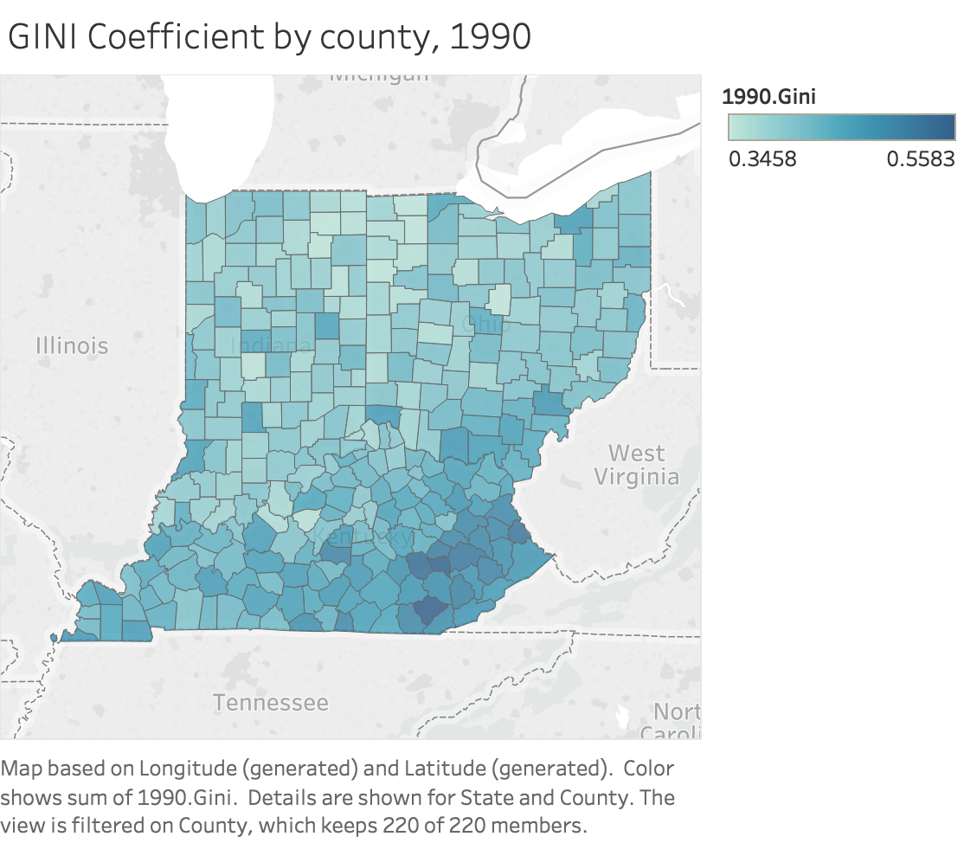

Slide 3
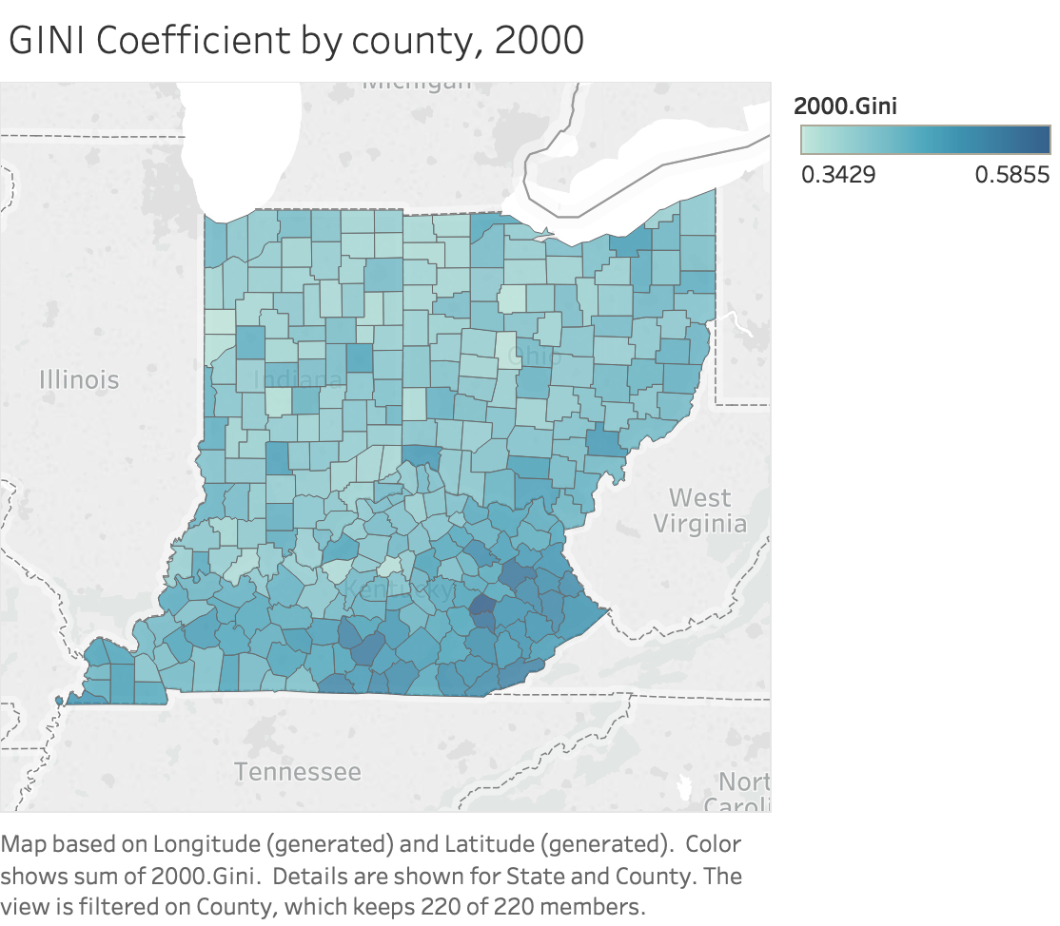

Slide 4
